Slide 1
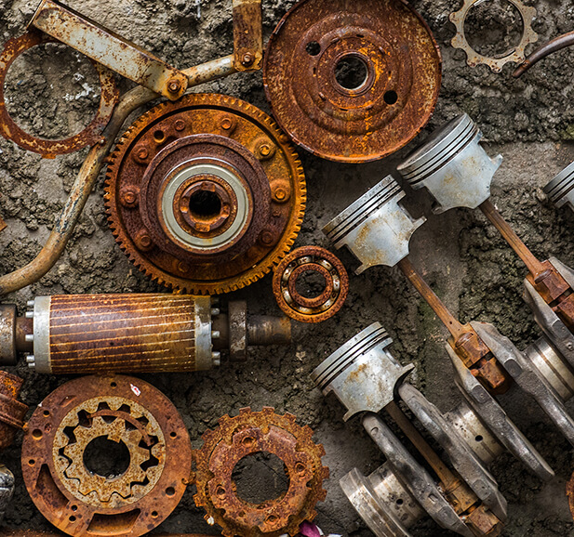
A Computer Vision-Based Framework for Industrial Corrosion Detection
Bayan Abdullah Aldahlawi - 202317310
Supervise by Dr. Muzammil Behzad

Slide 2
Agenda
Introduction
The experiment Objective
Methodology
Data description
Model Architecture
Experiment Execution - Focal loss
Experiment Execution - Attention block
Experiment Results
Conclusion

Slide 3

Introduction
Corrosion inspection uses traditional methods, including visual inspection, radiography, ultrasonic testing, and acoustic emission testing, often fail to detect corrosion accurately at an early stage, especially in locations that are difficult to reach or hidden areas. These constraints create the need for more effective and reliable inspection techniques. Nowadays, deep learning based advanced image recognition methods have demonstrated effectiveness in early-stage corrosion detection, providing faster, safer, and more accurate assessments compared to conventional methods.

Slide 4
The experiment Objective
This research aims to improve CNN architectures by integrating focal loss and attention blocks, and to compare the performance of three ResNet variants: ResNet18, ResNet50, and ResNet101 between the base model and the fine-tuned versions. The proposed approach enhances classification accuracy on imbalanced datasets and helps reduce overfitting.

Slide 5
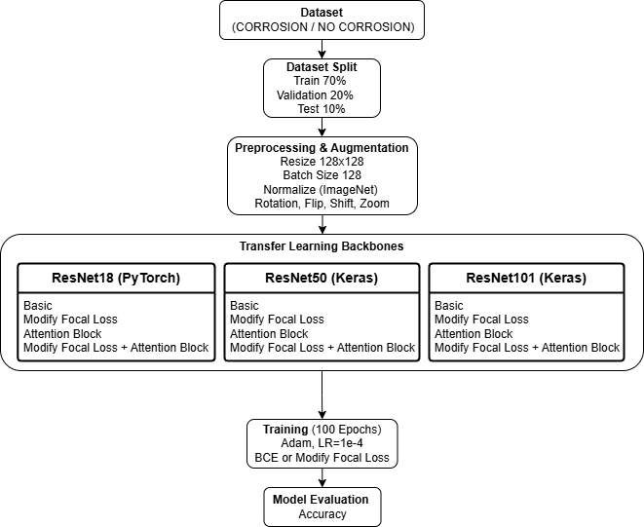
Methodology

Slide 6
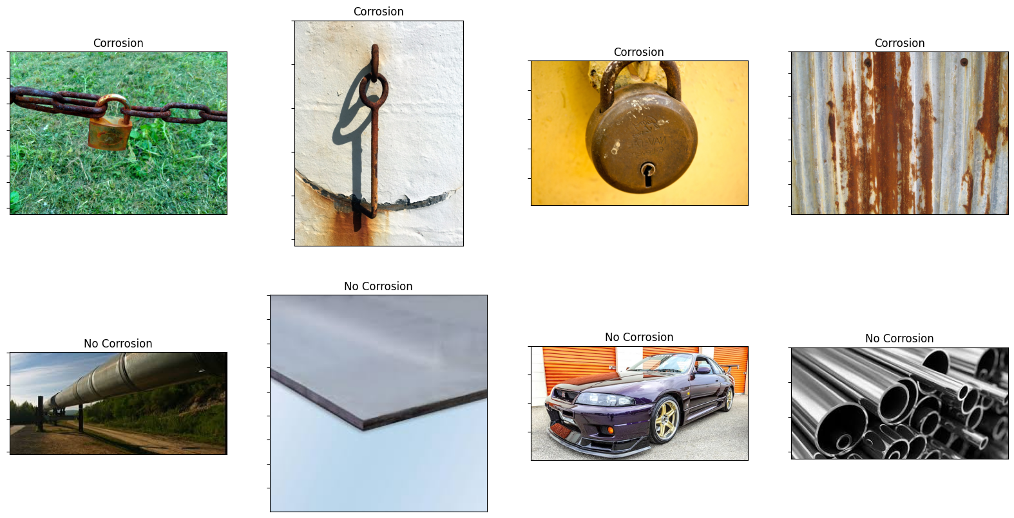
Data description

Slide 7
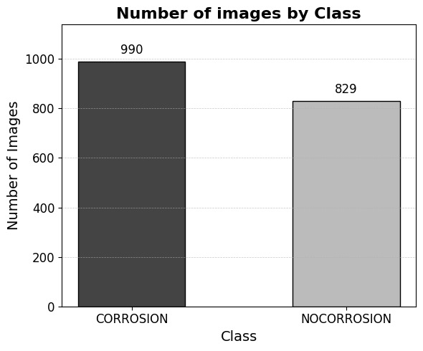
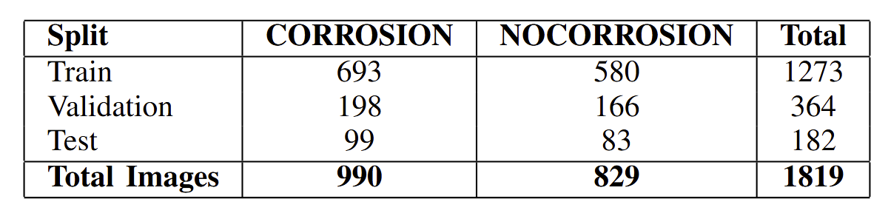
Data description

Slide 8
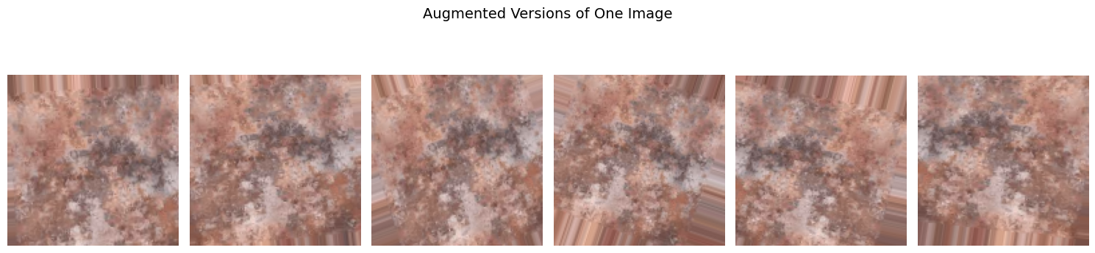
Data description

Slide 9
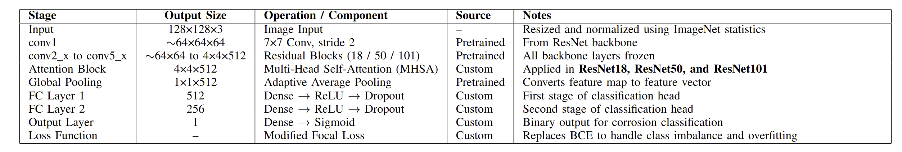
Model Architecture

Slide 10
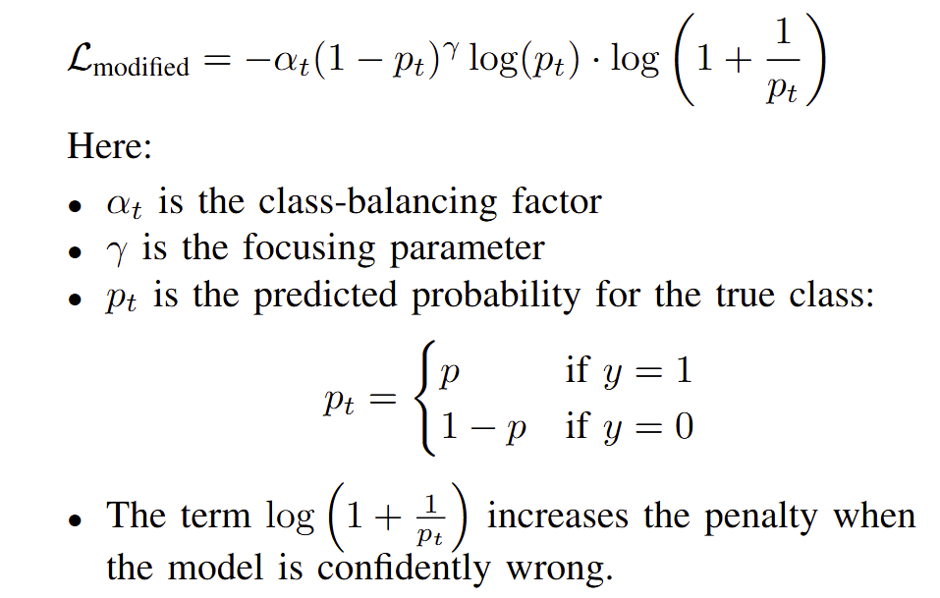
Experiment Execution - Focal loss

Slide 11
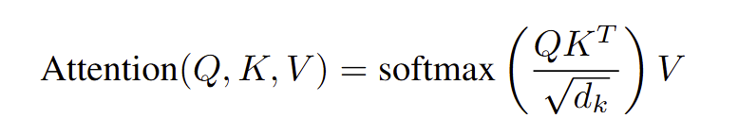
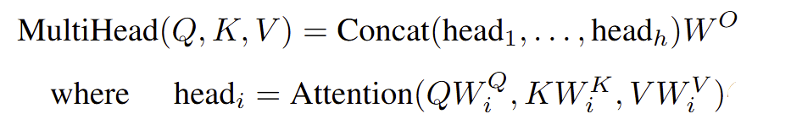
Experiment Execution - Attention block

Slide 12
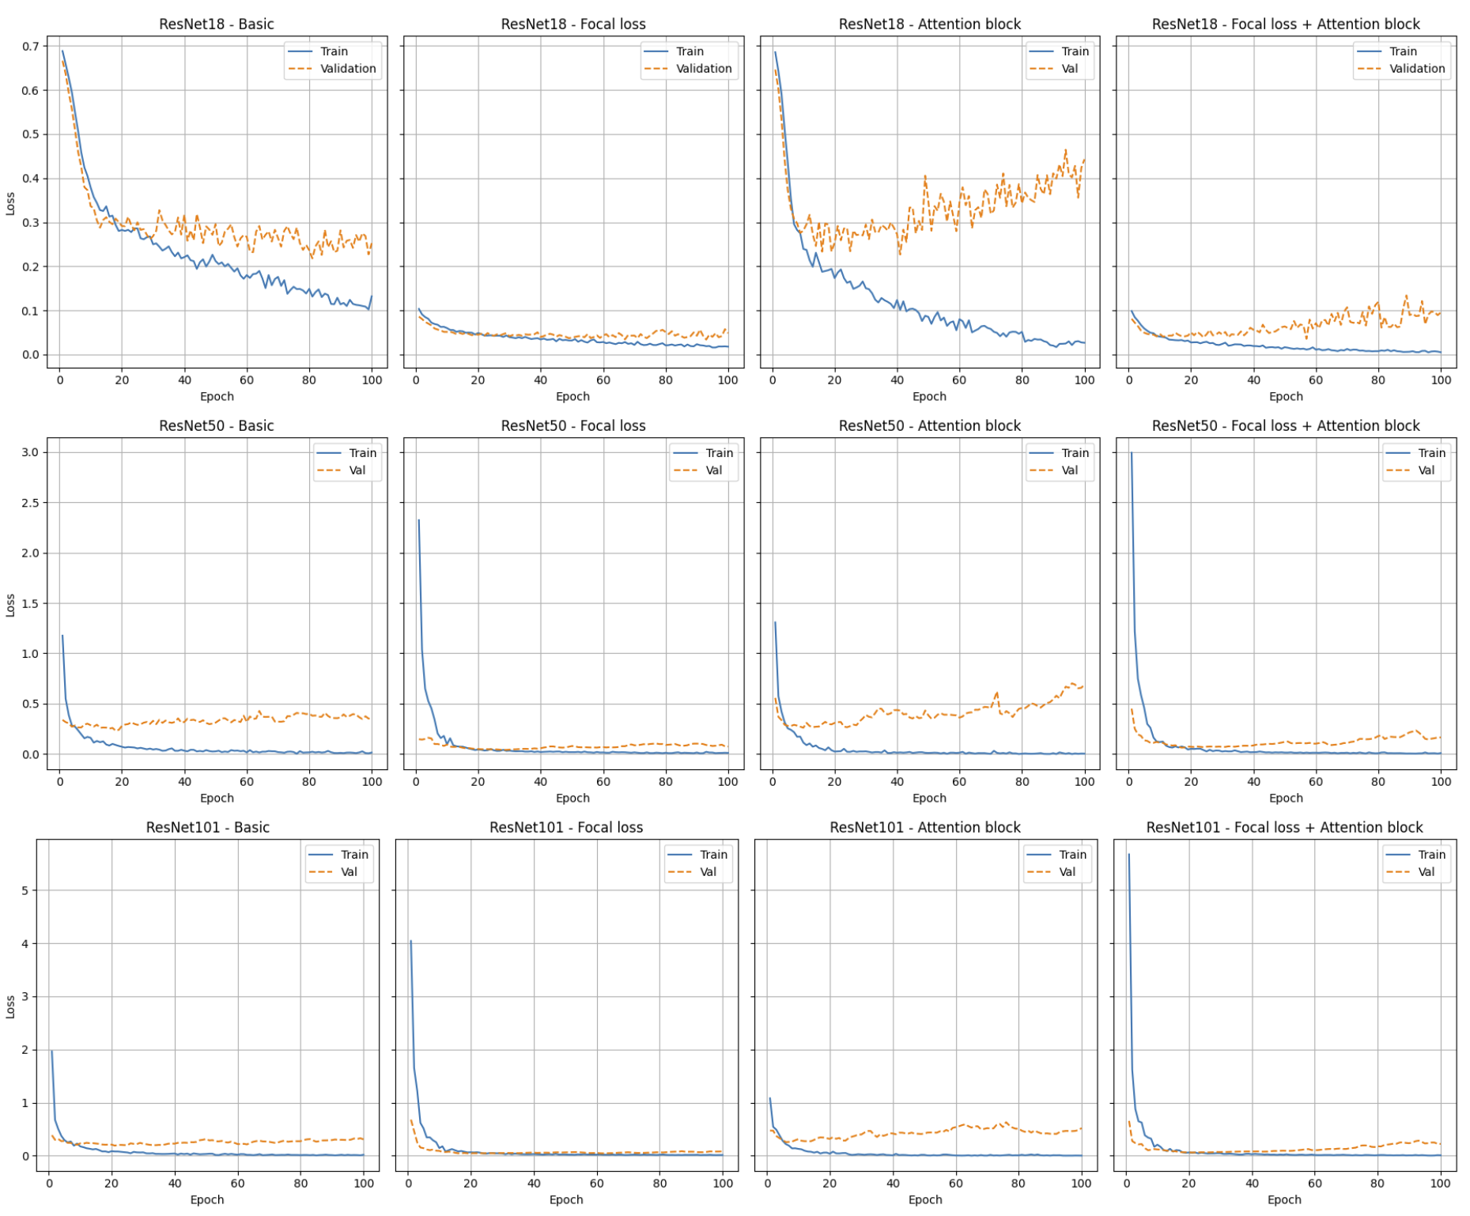
Experiment Results

Slide 13
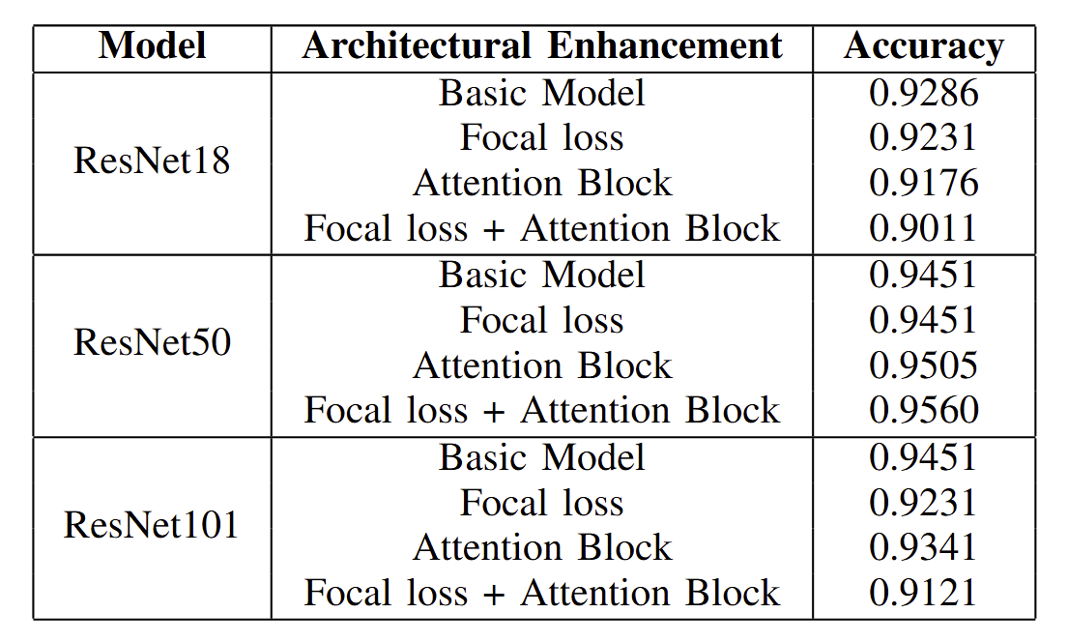
Experiment Results

Slide 14
Conclusion
The proposed paper investigates the original ResNet architecture and explores performance improvements by modifying the design through the integration of custom focal loss and Multi-Head Self-Attention mechanisms. The results demonstrate that the adjusted focal loss helps address class imbalance and reduces overfitting by narrowing the gap between training and validation loss, resulting in better generalization of the model on unseen data. Incorporating attention alongside focal loss enhances the model by focusing on specific important regions and minimizing noise.

Slide 15

Thank you
Bayan Abdullah Aldahlawi

